Slide 1
Camera Models and the Camera Matrix
Luke Thistlethwaite
October 7

Slide 2
First time attending?
Club Website: https://activities.tjhsst.edu/computervision/
Facebook Group: https://facebook.com/groups/602737413553837/
Officers: Luke Thistlethwaite, Yusuf Bham, Stephen Huan, Hashir Aqeel

Slide 3
How does a Camera work?
Digital Cameras (DSLR)
Lights is focused onto a silicon sensor
Advanced technology (DSP) does the rest
Older Cameras
Focuses light onto a piece of film
Film is developed to get an image

Slide 4
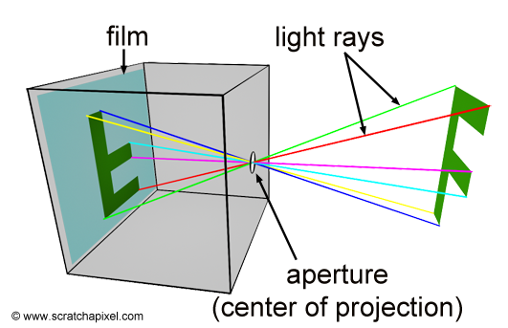
Pinhole Camera Model
Think of a camera as a small box
Light is let in through a pinhole
Image is projected upside down

Slide 5

Camera Obscura: Pinhole Example

Slide 6
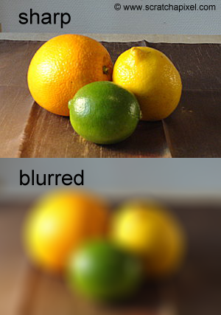
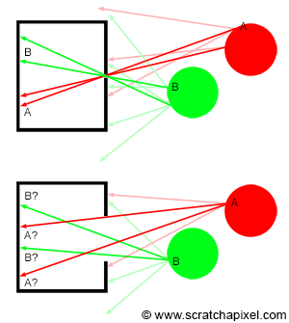
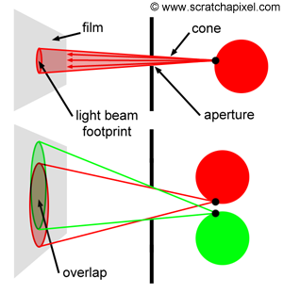
Why a Pinhole?
Too much light let in -> blurry image
Small aperture -> focused image

Slide 7
Issue with the Pinhole
Aperture (pinhole) is very small
Too few light beams makes the image dark
Needs long exposure time
People are impatient
Diffraction exists

Slide 8
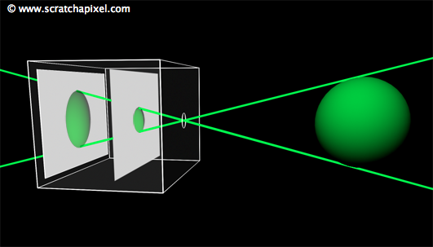
Pinhole Camera Properties
Field of View: Determined by how far away the image plane is from the aperture

Slide 9
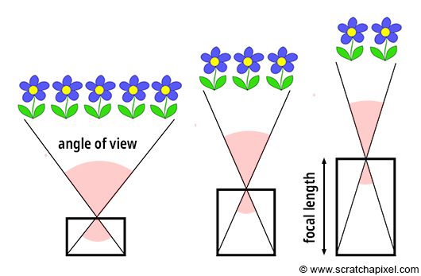
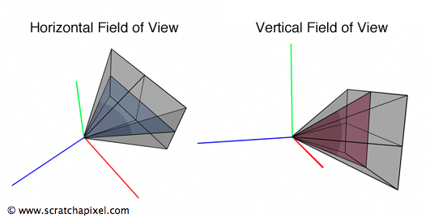
Pinhole Camera Properties
Focal length: Directly related to FOV, defined as the distance from the image plane to the aperture

Slide 10
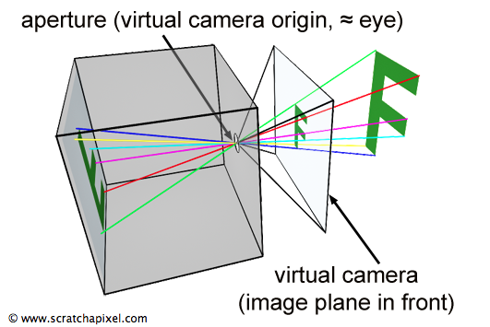
Representing a Camera (digitally)
Having the image plane behind the aperture is confusing
Let’s move it to the front!
Focal length is always assumed to be positive
Makes calculations easier

Slide 11
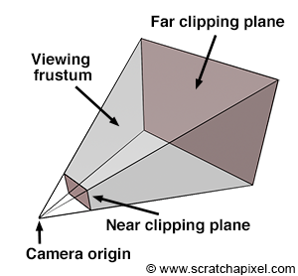
Video Games: Render Distance
Many games have a video setting called render distance
Controls what objects will be rendered

Slide 12
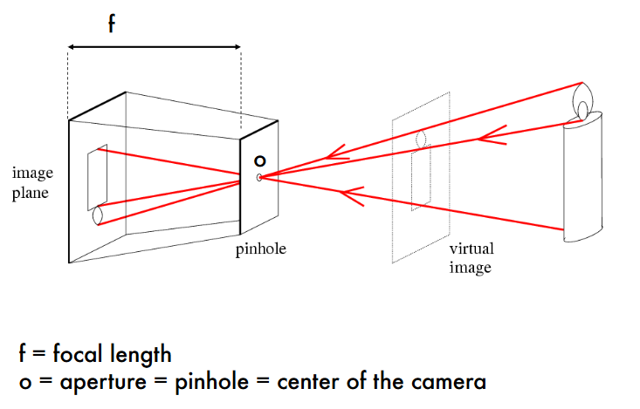
Pinhole Camera Summary

Slide 13
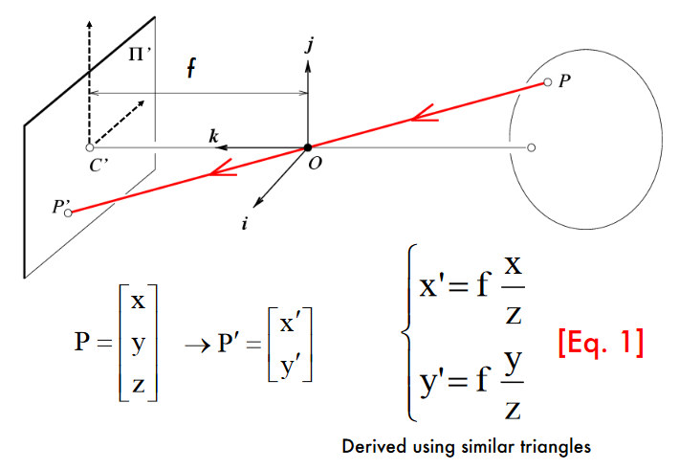
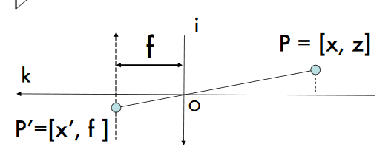
Mapping 3D Points to 2D

Slide 14
Coordinate Systems
World coordinate system (3D)
Defines position of an object in the physical world
Usually arbitrary
Camera coordinate system (3D)
Defines all objects relative to the camera
Film coordinates (2D)
Coordinates on the film
Pixel coordinates (2D)
Coordinates as they appear on your computer

Slide 15
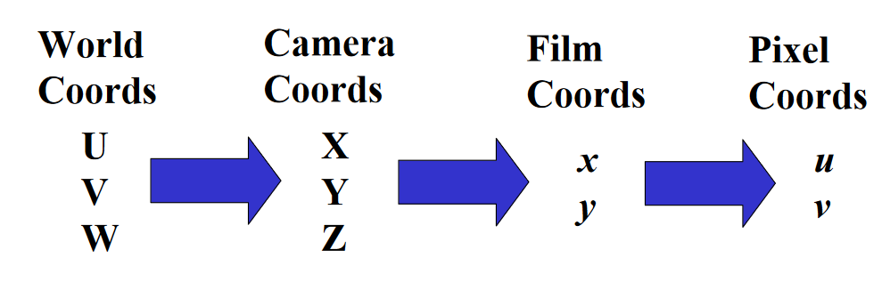
A Goal of Computer Vision
Obtain a mathematical model that can describe how 3D points in the world coordinate system get projected into 2D pixel coordinates

Slide 16
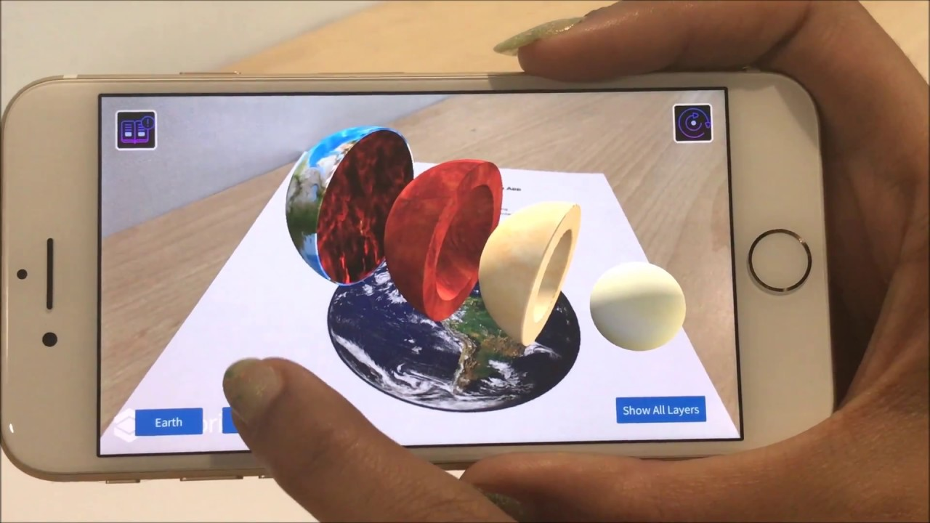
Application: Augmented Reality
What’s an example of mapping world coordinates to pixel coordinates?
Augmented Reality!
Points in an image -> Pixels

Slide 17
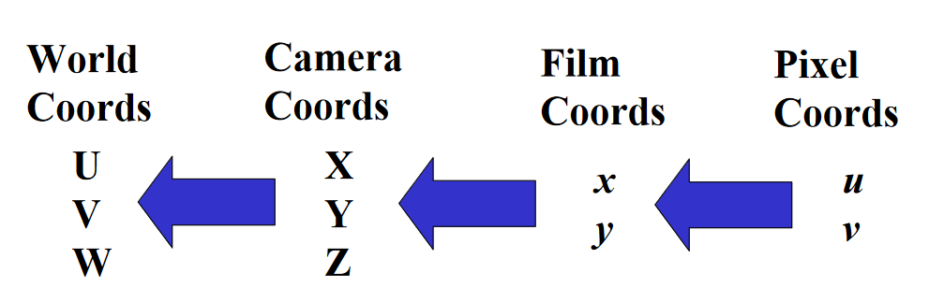
What about going backwards?
Just as important as being able to map points in the world to pixels

Slide 18
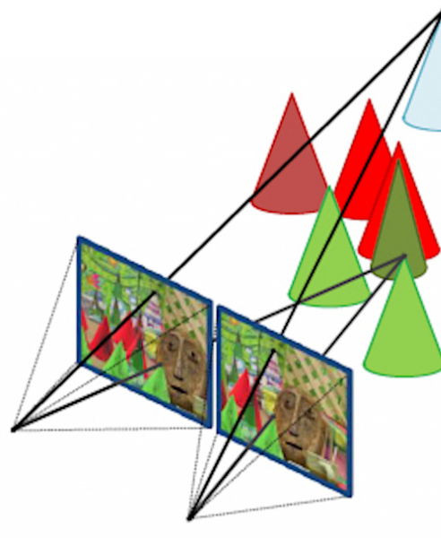
Application: Stereovision
Two cameras that are a known distance apart
Find features that are the same
Calculate depth/distance

Slide 19
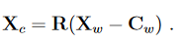
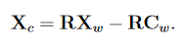
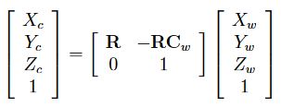
Mapping World Coords to Camera Coords
World coordinates can be translated into camera coordinates through some matrix operations

Slide 20
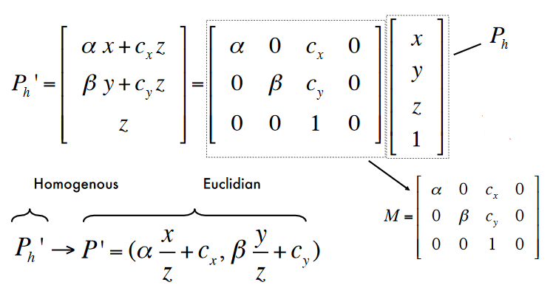
Mapping Camera Coords to Pixels
Similar to the mapping between world coordinates and camera coordinates, matrices are quite useful when mapping 3D camera coordinates to pixel locations

Slide 21
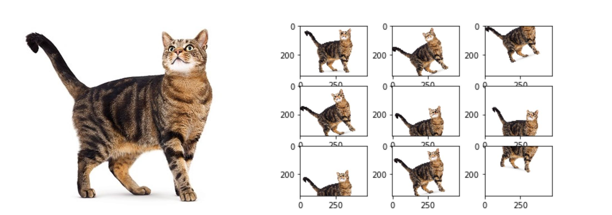
Next Week: Translations and Transformations
Kaggle Competition: Data Augmentation

